Slide 1
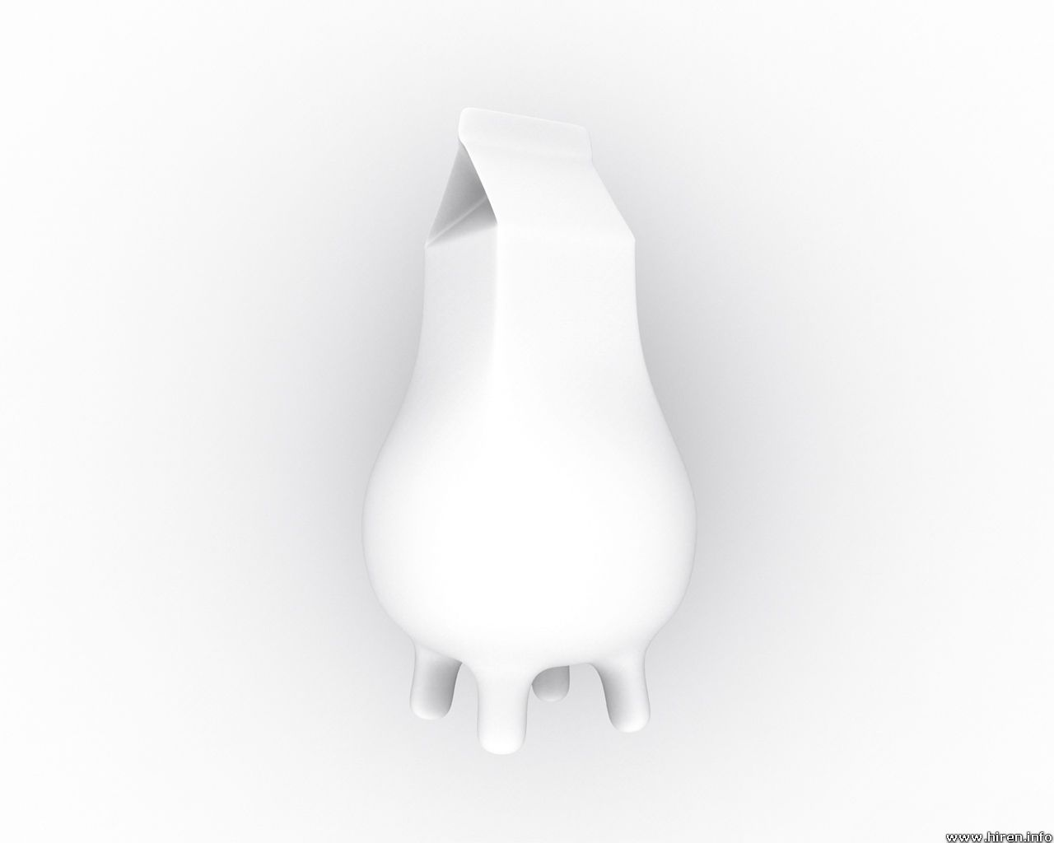
Pasteurisation
R1555
Dairy Processing handbook –
Tertra Pak Processing Systems
Tania Blignaut tania@dairystandard.co.za
0824183471

Slide 2
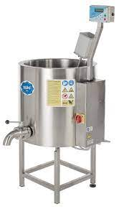
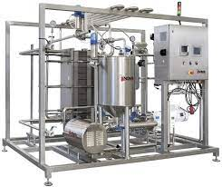
REGULATIONS RELATING TO MILK AND DAIRY PRODUCTS
Published under Government Notice No. R. 1555 of 21 November 1997
Definition
“pasteurisation” means the heat treatment, as described in Annex B, of a dairy product or an imitation dairy product so that -
(a) all vegetative pathogens are
destroyed; and
(b) in the case of milk, the result of the
phosphatase test described in
paragraph 3 of Annex A is negative and,
(c) if the product concerned does not undergo
further processing, the cooling thereof to
below 5ºC immediately after having been
thus heat treated;

Slide 3
REGULATIONS RELATING TO MILK AND DAIRY PRODUCTS
Published under Government Notice No. R. 1555 of 21 November 1997
ANNEXURE B
PASTEURISATION
The pasteurization of milk shall be performed –
(a) by heating every particle of the milk to as temperature of at least 63ºC (not exceeding 65,5ºC) and keeping it at that temperature for at least 30 minutes, which heating shall be followed by cooling within 30 minutes to a temperature lower than 5ºC (this process is referred to as the “ holder method” or the “ batch method”); or
(b) by heating every particle of the milk to a temperature of at least 72ºC and keeping it at that temperature for at least 15 seconds, which heating shall be followed immediately by
cooling to a temperature lower than 5°C (this process is hereinafter referred to as the“ high-temperature short -time method”); or
(c) by any other method prescribed by regulation:
Provided that milk shall in no instance be deemed to have been pasteurized if it fails to pass the Aschaffenburg and Mullen phosphate test descried in paragraph 3 of Annexure A or any other test, provided the accuracy thereof equals that of the Aschaffenburg and Mullen phosphatase test.

Slide 4
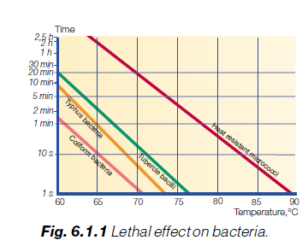
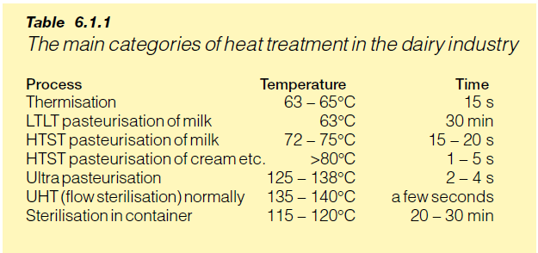
Main categories of heat treatment in the dairy industry

Slide 5
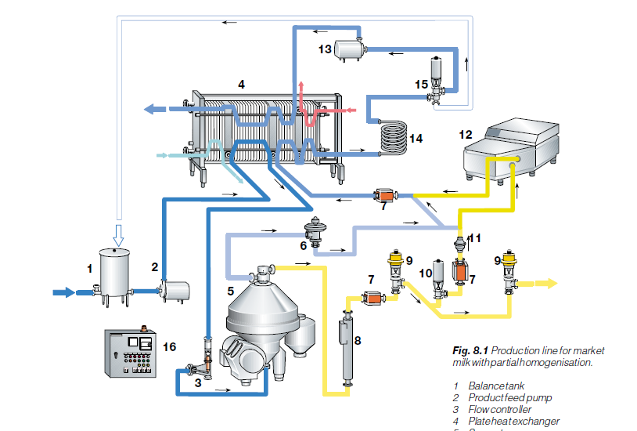
Production line Milk
Notes:
Validation – Is your equipment doing what it is suppose to be doing.
Flow Divert Valve
Flow rate of milk; Is it kept in the holding tube at 72C for 15 seconds

Slide 6
REGULATIONS RELATING TO MILK AND DAIRY PRODUCTS
Published under Government Notice No. R. 1555 of 21 November 1997
ANNEXURE B
PASTEURISATION
2. Cream and milk or dairy products containing added sweeteners shall be pasteurized as follows:
(a) by heating every particle of the product to a temperature of at least 66°C and keeping it at this temperature for at least 30 minutes; or
(b) by heating every particle of the product to a temperature of at least 74ºC and keeping it at this temperature for at least 15 seconds; or
(c) by any other method prescribed by regulation: Provided that such product shall in no instance be deemed to have been pasteurized if it fails to pass the Aschaffenburg and Mullen phosphatase test described in paragraph 3 of Annexure A or any other test , provided the accuracy thereof equals that of the Ascaffenburg and Mullen phosphatase test .

Slide 7
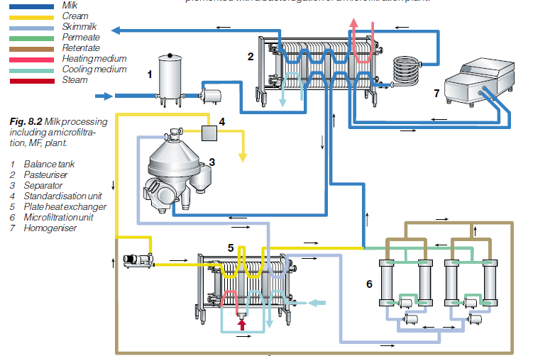
Production line Cream

Slide 8
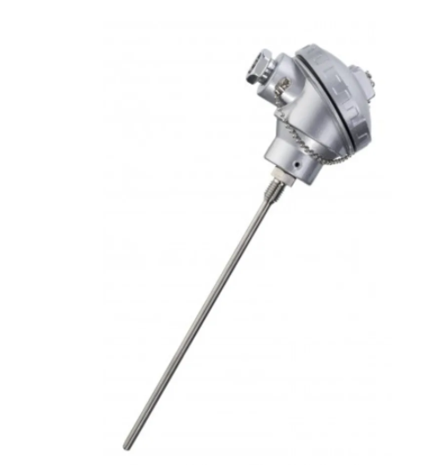
REGULATIONS RELATING TO MILK AND DAIRY PRODUCTS
Published under Government Notice No. R. 1555 of 21 November 1997
ANNEXURE B
PASTEURISATION
3. The process of pasteurisation, if carried out according to the high-temperature short-time method, shall be mechanically controlled with regard to the temperature range of the milk and the period for which milk is kept at the prescribed temperature, and the apparatus concerned shall be calibrated monthly to ensure the correctness of the pasteurisation process.
Processing Records

Slide 9
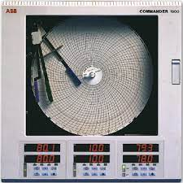
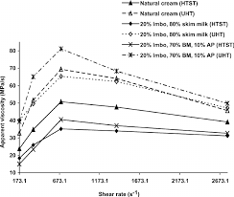
REGULATIONS RELATING TO MILK AND DAIRY PRODUCTS
Published under Government Notice No. R. 1555 of 21 November 1997
ANNEXURE B
PASTEURISATION
4. Thermographic recording of temperatures of pasteurization by any method shall be made and retained for at least four weeks.

Slide 10
Summary
Temperature / Time
  Equipment used (Bulk vs Plate)
  Product to be pasteurised (Milk, Cream
Equipment
  Holding tube – Flowrate of milk through pasteuriser
  Flow Divert valve – Test
  pT100 – Calibration/Verification
Record keeping
  Thermographic Recording
  Processing Record
    Record all parameters at specific times.
    Verification
Aschaffenburg and Mullen phosphate

Slide 11
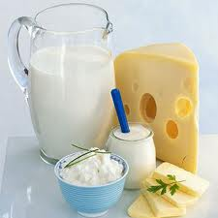
Thank you

